Slide 1
Experiment - 3
QPSK
Ritu Ann Roy George
B170106ec
S7 ece b batch

Slide 2
AIM
To generate a random sequence of about 512 QPSK symbols and apply pulse shaping with a square-root raised cosine (SRRC) pulse (roll off =0:35). Use an over-sampling ratio of 8x symbol rate and a truncation length of 10 symbols for the SRRC pulse. Use Gray Coding for the QPSK symbols. Assume that the symbol rate is 25Ksymbols/sec.
a. Plot the original constellation diagram for the transmitted symbols assuming no noise.
b. Add AWGN with different variance values and plot the constellation diagram for SNR=10 dB.
c. Pass the signal and noise through a matched receive filter (same SRRC filter as used in the transmitter).
d. Plot the eye diagram of the received signal and interpret it.
e. Apply coherent detection and compute BER for Eb/No in [0; 14dB] in steps of 2 dB
f. Plot BER and SER (Symbol Error Rate) versus Eb/No. Verify BER plot (simulations) with an analytical computation of BER for QPSK.

Slide 3
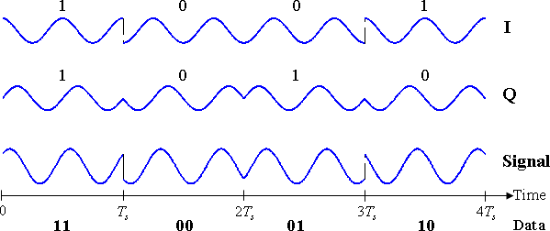
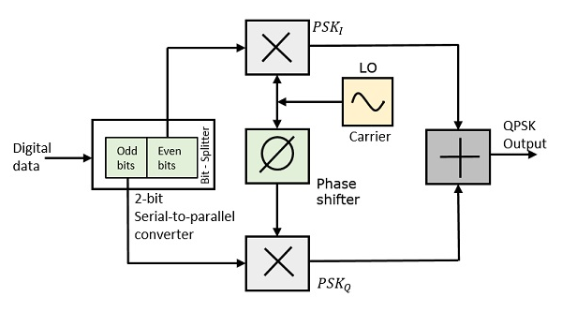
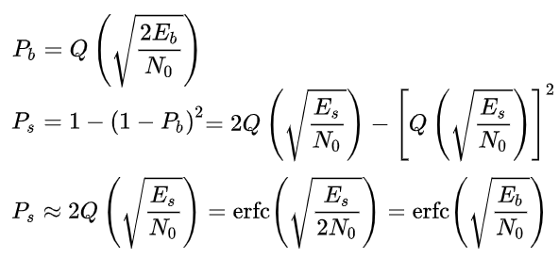
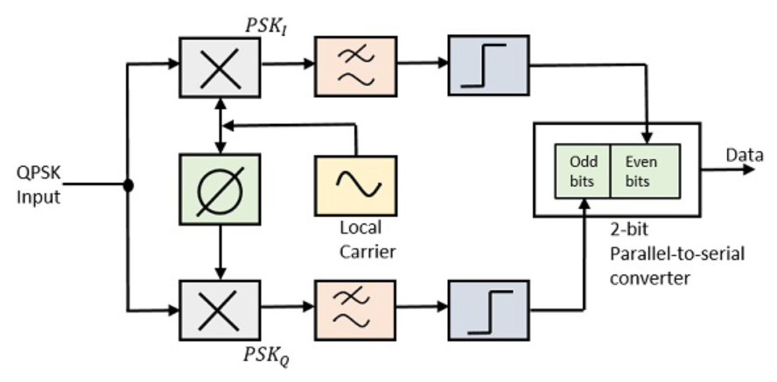
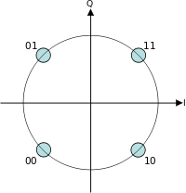
Theory
The Quadrature Phase Shift Keying QPSK is a variation of BPSK, and it is also a Double Side Band Suppressed Carrier DSBSC modulation scheme, which sends two bits of digital information at a time (converts them into bit pairs) called as bigits.
Bit Error Rate: It is the number of bit errors per unit time.
Symbol Error Rate: It is the number of symbol errors per unit time.
QPSK
Modulation and Demodulation
Gray Coding

Slide 4
Square Root Raised Cosine (SRRC) Pulse Shaping
SRRC is frequently used as the transmit and receive filter in a digital communication system to perform matched filtering. This helps in minimizing intersymbol interference (ISI). The combined response of two such filters is that of the raised-cosine filter.
The total effective filter of the transmission system is the combination of transmit and receive filter gTX* gRX, where ∗ is convolution. This effective filter (and not the individual filters) must fulfill the Nyquist criterion. This goal can be achieved if both filters have a transfer function that is equal to the square root of that of the raised cosine filter. Such a filter is therefore called a root raised cosine (RRC). The combination of both RRC filters then becomes a raised cosine and thus fulfills the Nyquist criterion. Furthermore, since the filters are real valued and symmetric, the RRC is its own matched filter.

Slide 5
Algorithm
Step 1: Transmitting End:
Generate random bits of 1s and 0s (for gray coding). Combine 2 bits as the real and imaginary parts of the complex numbers.
Form the NRZ qpsk symbols (0 as -1 and 1 as 1) and add AWGN (Gaussian noise).
Step 2: Filtering Action:
A raised cosine filter is designed with the given roll off factor, truncation length and samples per seconds.
The noise added signal is upsampled by a factor of 8*250.
This signal is convoluted with the raised cosine filter.
The first and last 10000 bits are removed from the sequence.
It is downsampled by 8*250.
Step 3: Receiving End:
By coherent detection, make decision on the received signals and regenerate the qpsk symbols.
Compare with the transmitted signals and find the BER and SER for various values of SNR.
for i = 1:length(q_complex)
q_reconst(i) = (0+0i);
if real(d(i)) >0
q_reconst(i) = q_reconst(i) + (1+0i);
else
q_reconst(i) = q_reconst(i) + (-1+0i);
end
if imag(d(i)) > 0
q_reconst(i) = q_reconst(i) + (0+1i);
else
q_reconst(i) = q_reconst(i) + (0-1i);
end
end

Slide 6
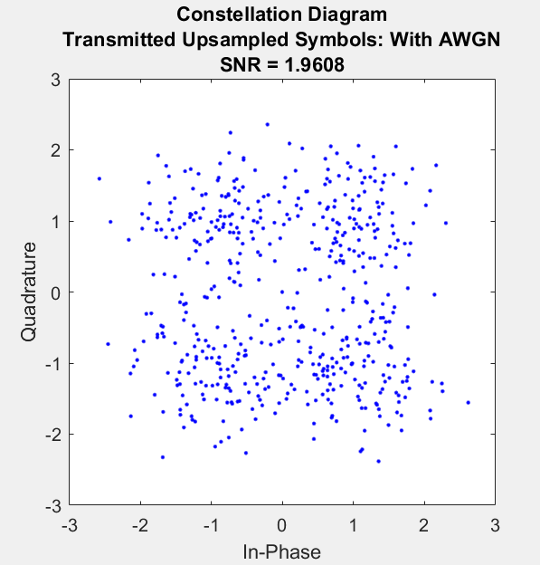
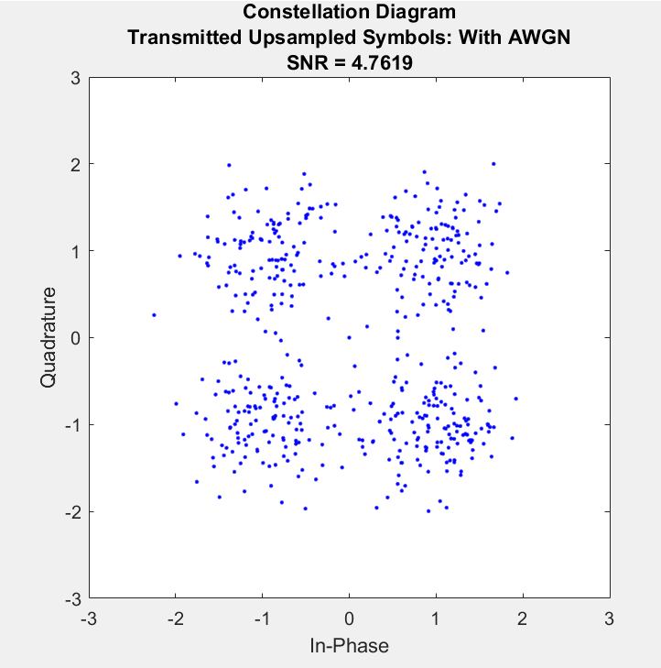
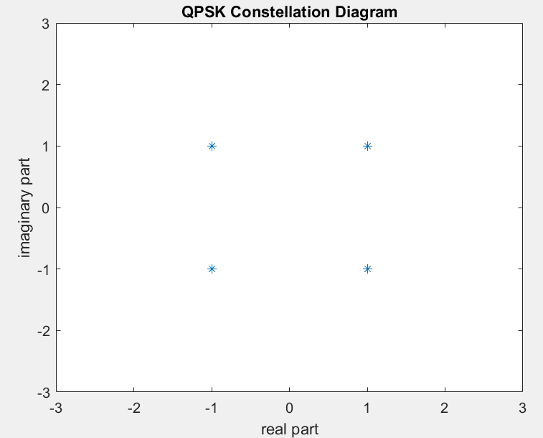
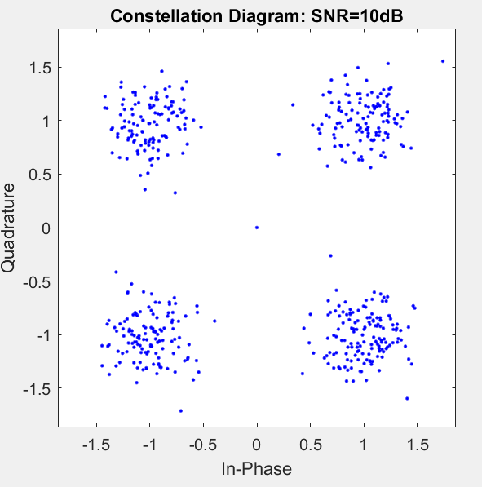
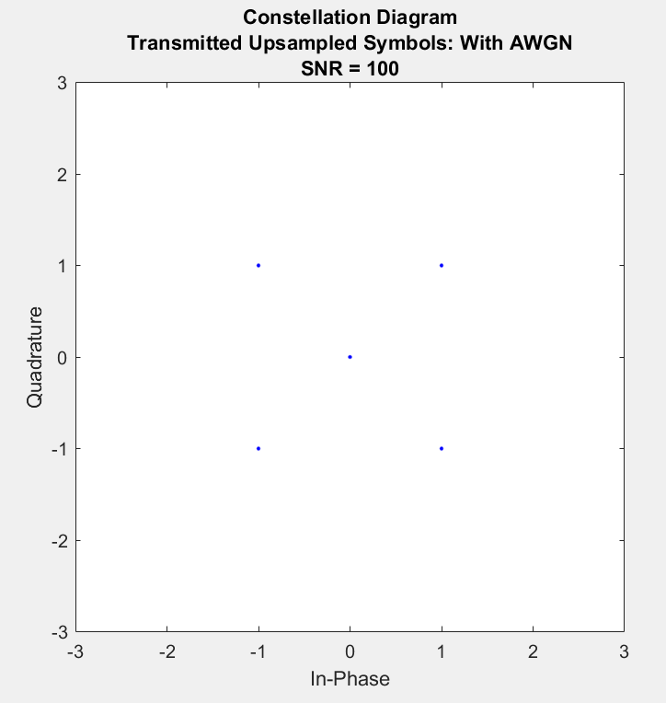
Observations:
Constellation Diagram of QPSK

Slide 7
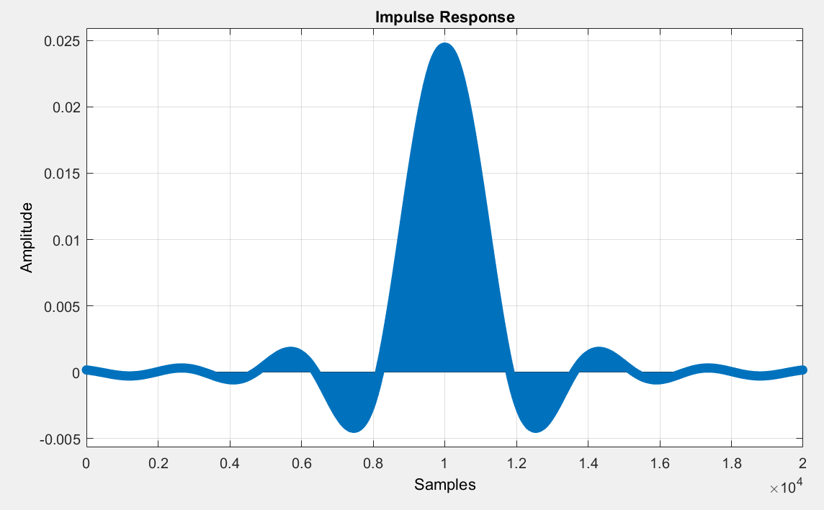
Observation: FILTER
Raised Cosine Filter:
(ie convolution of SRRC at Tx and Rx)
Oversampling rate = 8*250 sym/s
Truncation Length = 10 symbols
Roll off factor = 0.35

Slide 8
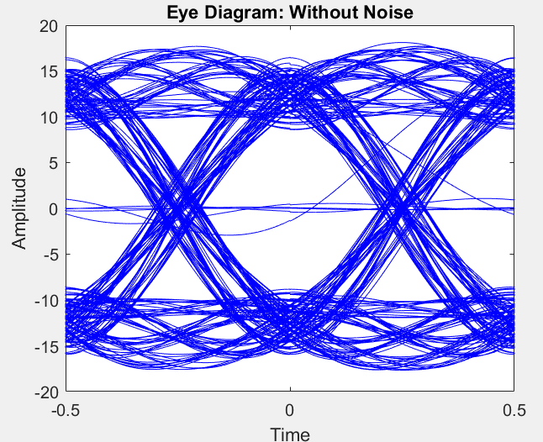
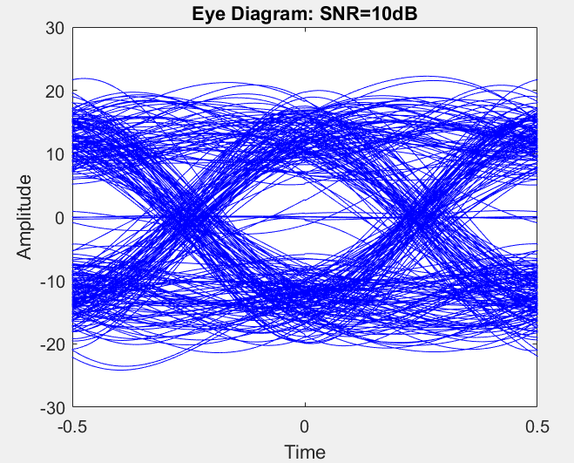
Observations: EYE DIAGRAM

Slide 9
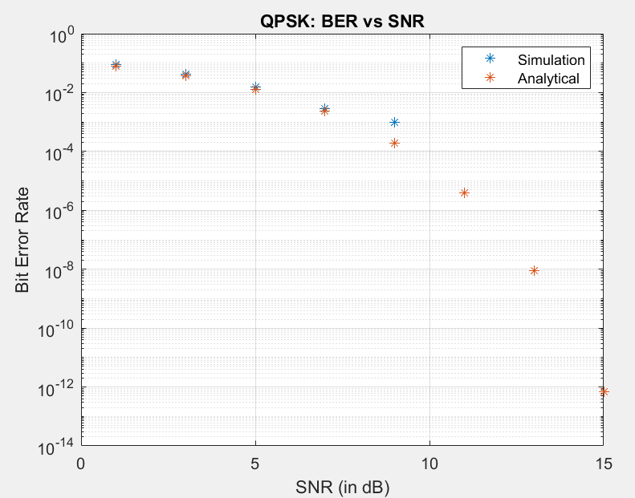
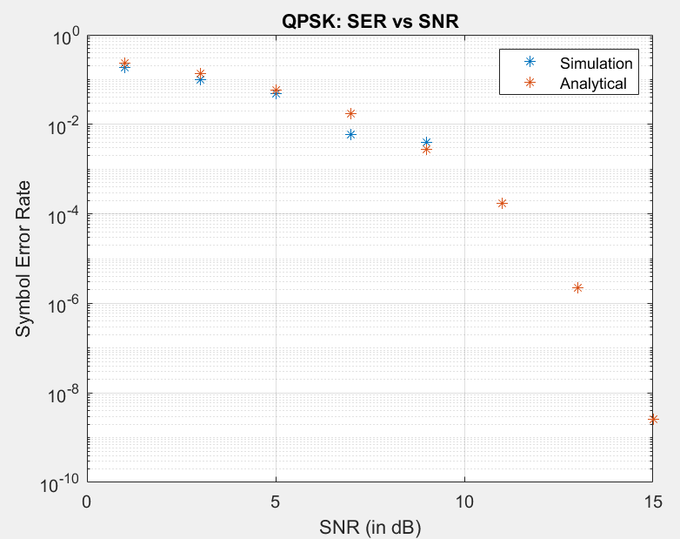
Observations: BER and SER vs SNR
Symbol rate = 250 symbols/sec

Slide 10
INFERENCE:
1. QPSK is advantageous in terms of bandwidth efficiency. A QPSK system transmits 2 bits during each symbol period. Thus, its bandwidth efficiency is (ideally) higher by a factor of two, compared to BPSK, which uses two possible phase shifts instead of four, and thus transmits only one bit per symbol.
2. There is an introduction of point (0,0) while upsampling.
3. The eye diagram is seen to have fluctuations when the signal is noisy. Still at SNR = 10dB, it maintains the original shape.
4. As SNR increases, both the BER and SER decrease, similar to the analytical calculations.
Hence, as the value of SNR increases, the scattering of received symbols decreases i.e, most of the symbols received will be closer to actual symbol points [(1,1),(-1,1),(-1,-1),(1,-1)] (nrz form of the Gray Coding QPSK symbols 11 01 00 10)
RESULT:
The variation of signal and the error as we change the SNR is observed in QPSK technique.

